Slide 1
How to import Allegro PCB document to Altium

Slide 2
File setup

Slide 3
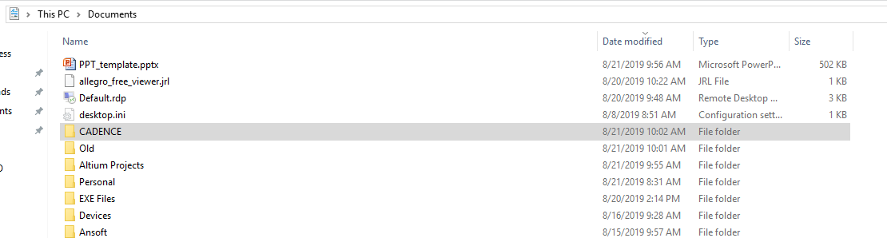
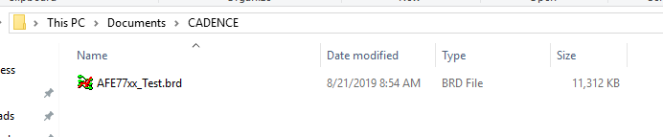
1. Create new local folder (I named new folder “CADENCE” in my documents)
2. Place Allegro .brd file(Using AFE77xx .brd file as example)

Slide 4
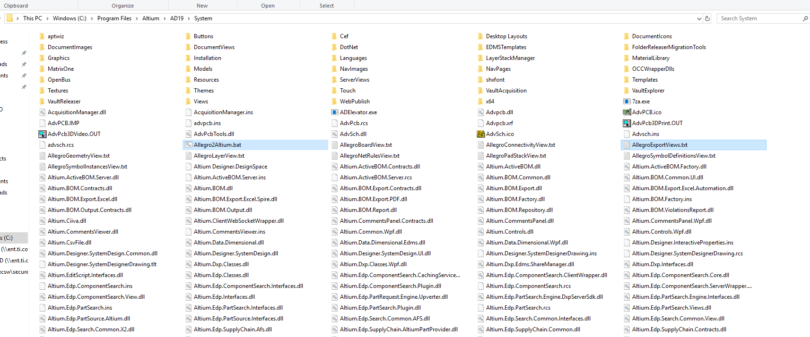
3. Navigate to following path (C:\Program Files\Altium\AD19\System)
3. Copy Files “Allegro2Altium.bat” & “AllegroExportViews.txt”

Slide 5
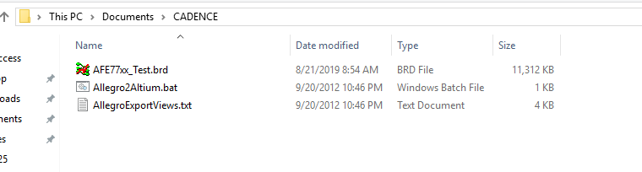
4. Paste them into recently created folder containing .brd file

Slide 6
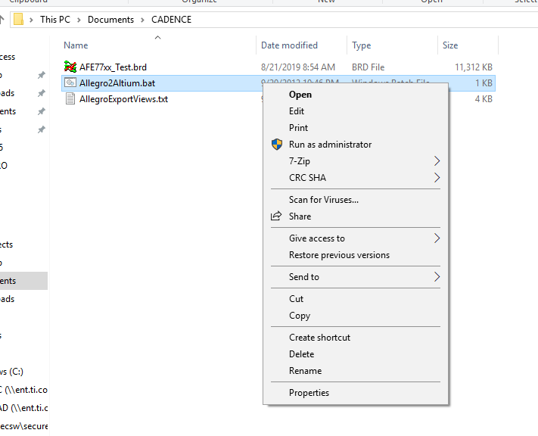
5. Right click on “Allegro2Altium.bat” file and select EDIT

Slide 7
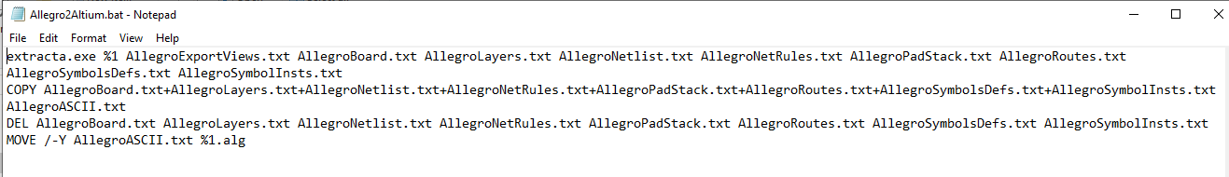
5b. Verify that file looks as follows. in the next steps we will modify the first line of this document by adding the path for “extracta.exe”.

Slide 8
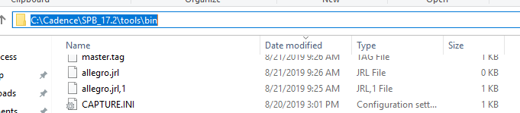
6. Navigate to the following path
7. Highlight and Copy (C:\Cadence\SPB_17.2\tools\bin)

Slide 9
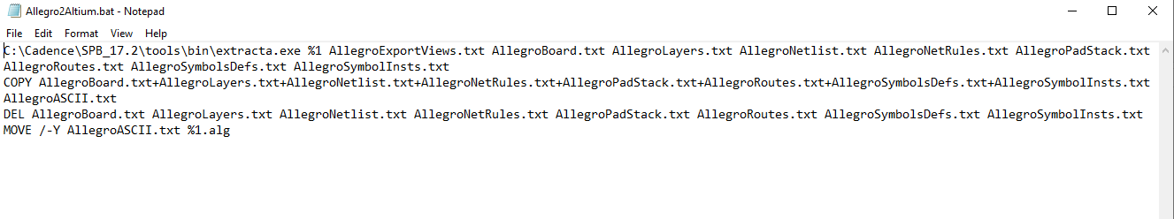
8. Paste the copied path to the front of the first line & then save
Should look like this…
*Don’t forget to add the “\” before extracta.exe

Slide 10
Now that modified files are properly placed. We need to run .exe responsible for converting .brd file to .agl

Slide 11
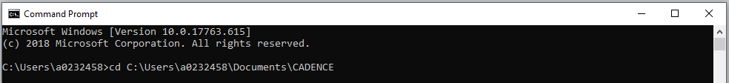
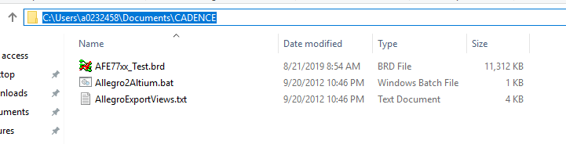
1. Run cmd and change directory to created folder

Slide 12
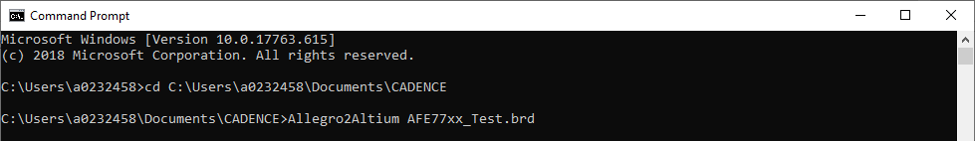
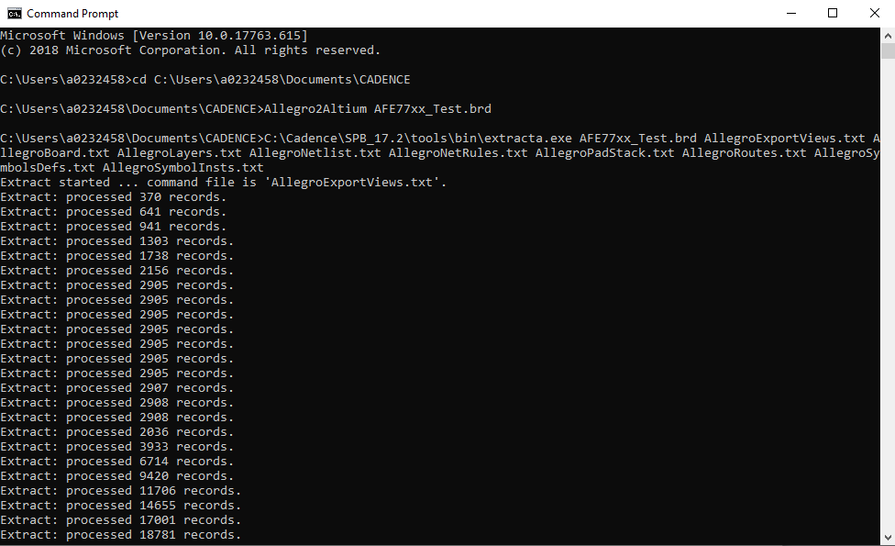
2. Type “Allegro2Altium *file_name.brd* and press enter
3. Let the extractions begin… will take a couple of minutes. Wait until…

Slide 13
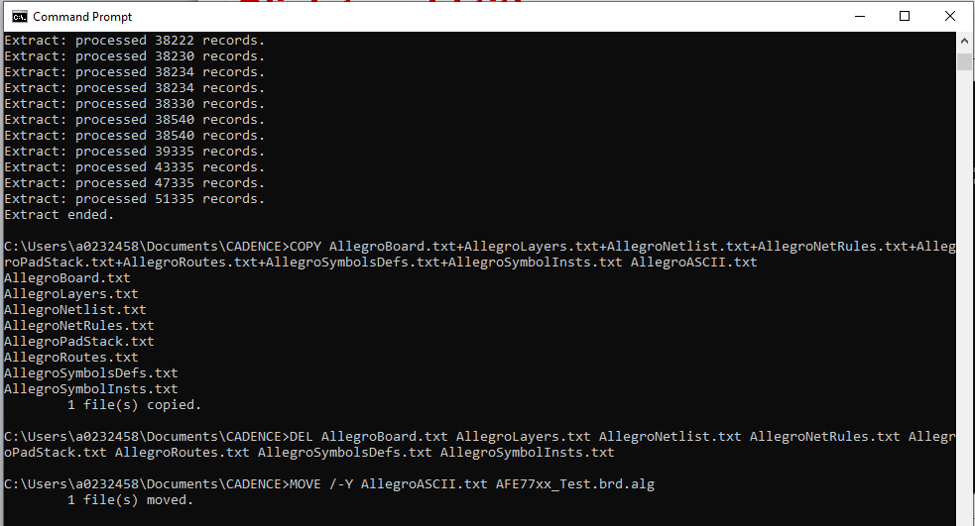
4. Conversion is complete when you see extration is ended and. *.alg file has been created.

Slide 14
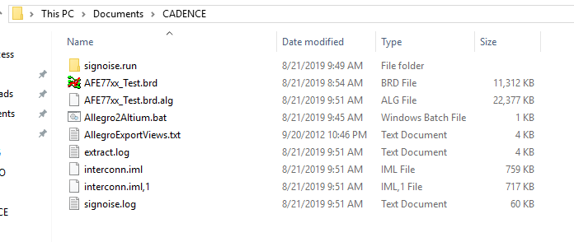
* Here’s my Cadence folder before and after extraction for reference.
Before
After

Slide 15
Importing .ALG file into Altium

Slide 16
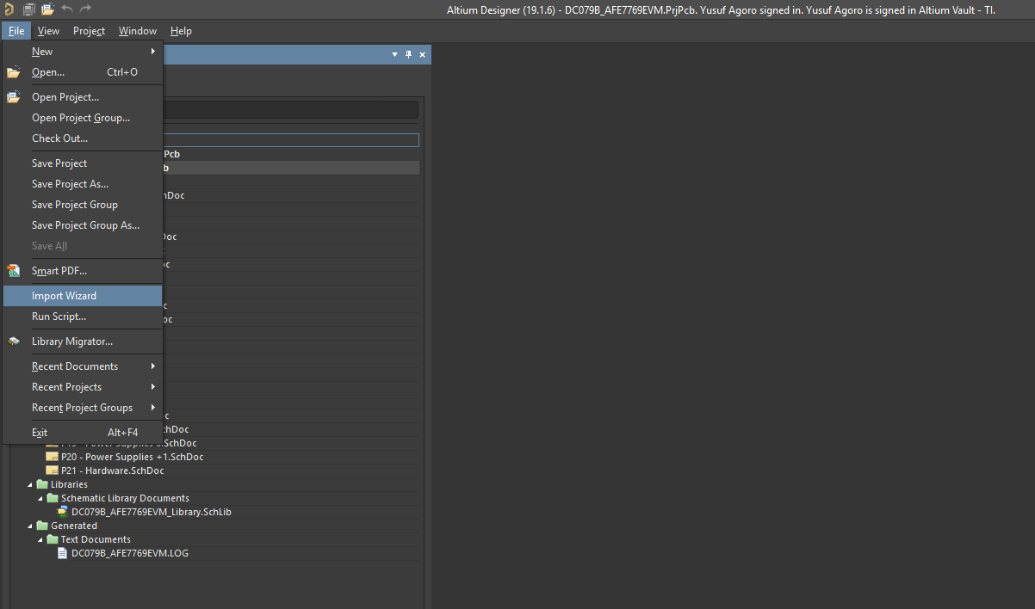
1. File→ Import Wizard

Slide 17
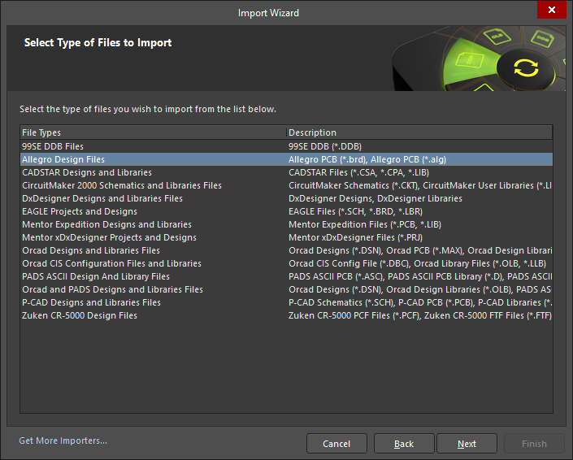
2. Select Allegro Design Files then Next

Slide 18
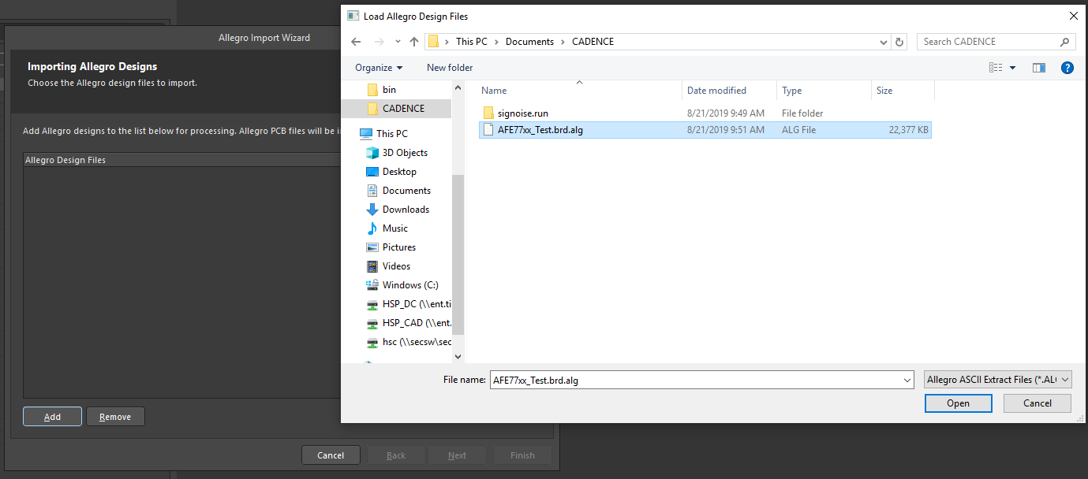
3. Click Add 4. Change File time to Allegro ASCII Extract Files (*.ALG) 5. Open *File_name.brd.alg file
5
3
4

Slide 19
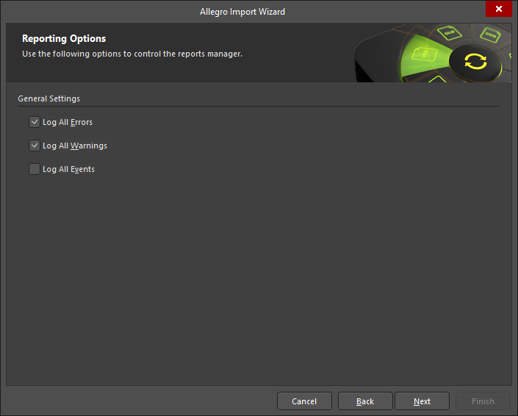
6. Select following options → Next

Slide 20
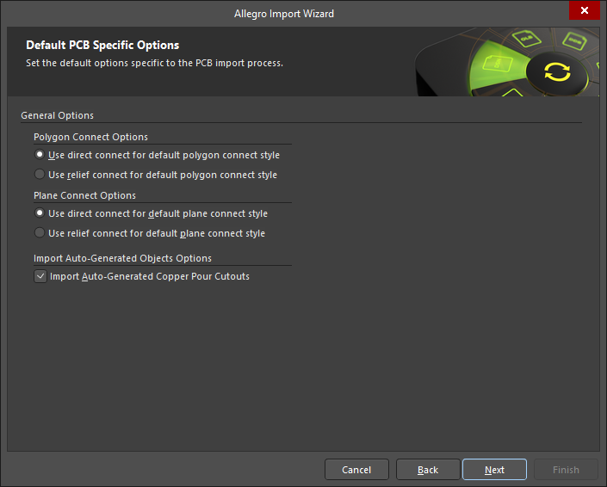
7. Select following options → Next

Slide 21
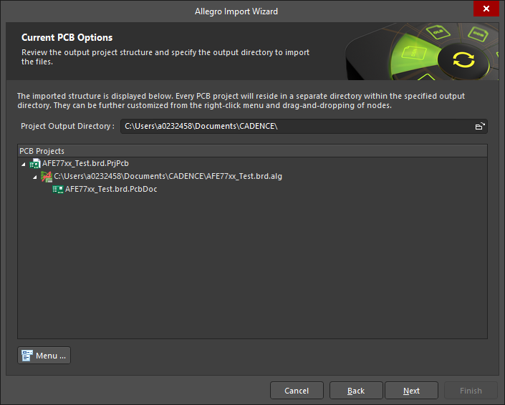
8. Next

Slide 22
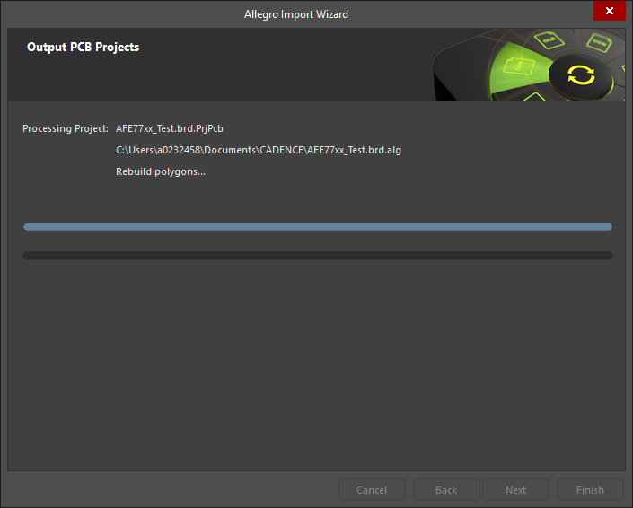
Wait..

Slide 23
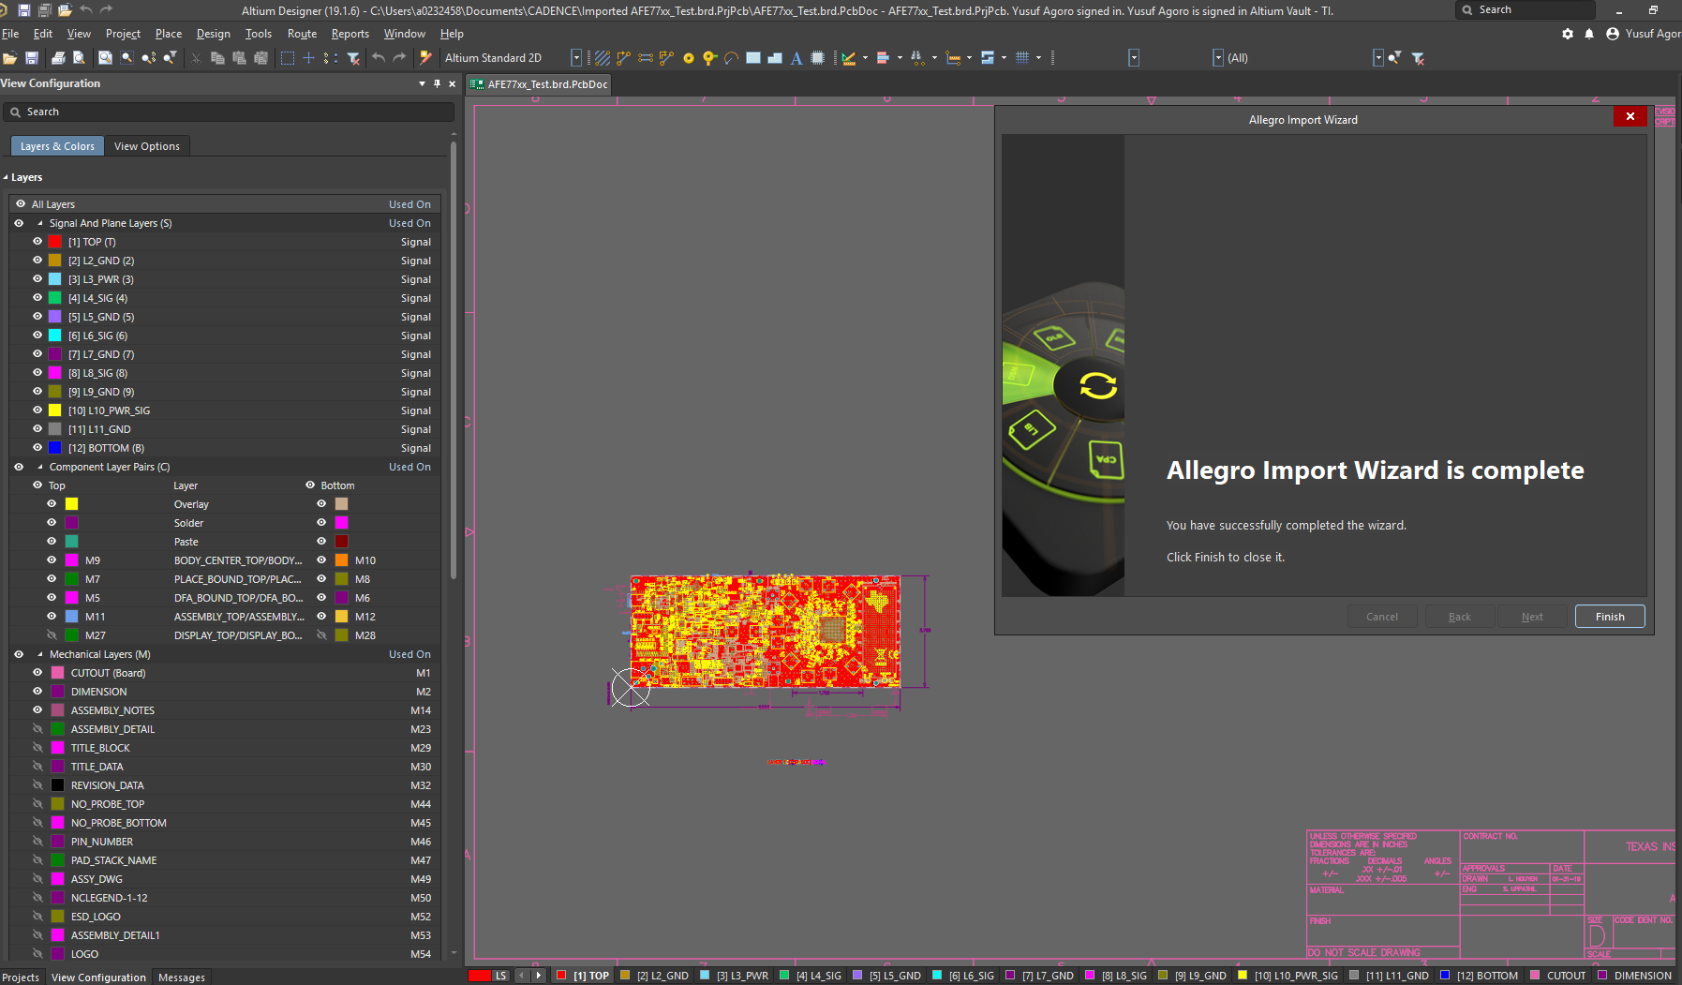
Complete

Slide 24
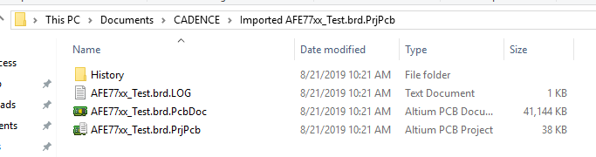
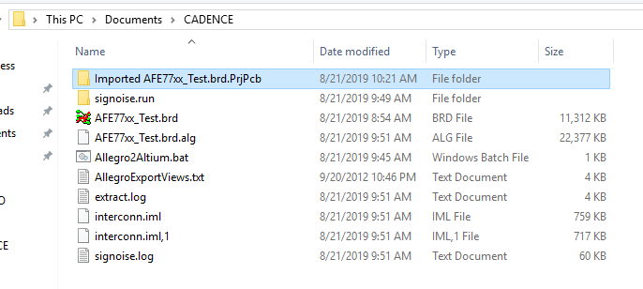
Newly Imported PCB doc’s found in Cadence file.

Slide 25
How to import OrCAD Schematics to Altium

Slide 26
1. File→ Import Wizard

Slide 27
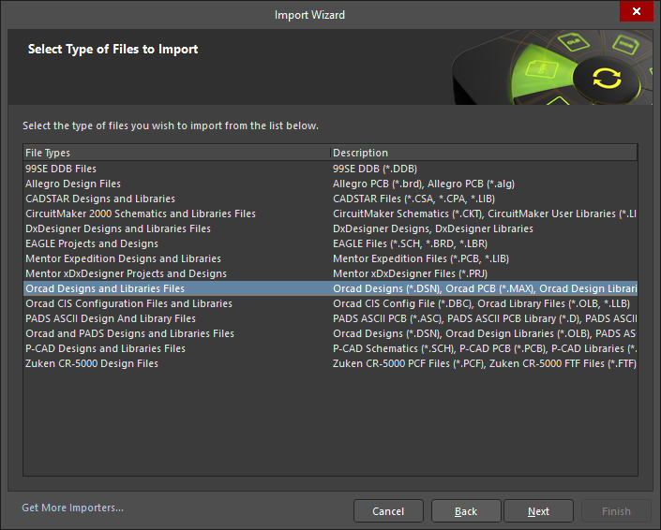
2. Select “Orcad Designs & Lib…” → Next

Slide 28
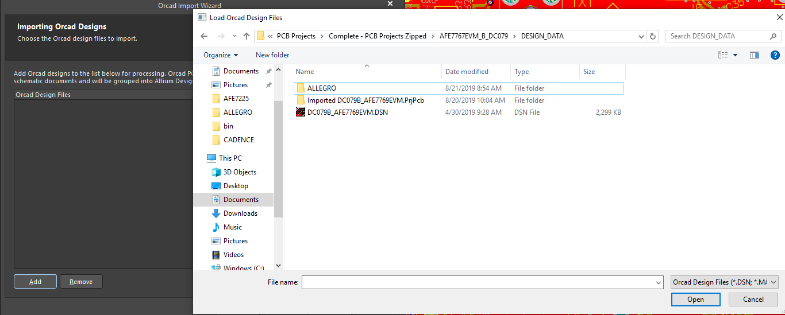
3. Click Add 4. Open *file_name.DSN for Allegro Doc
4
3

Slide 29
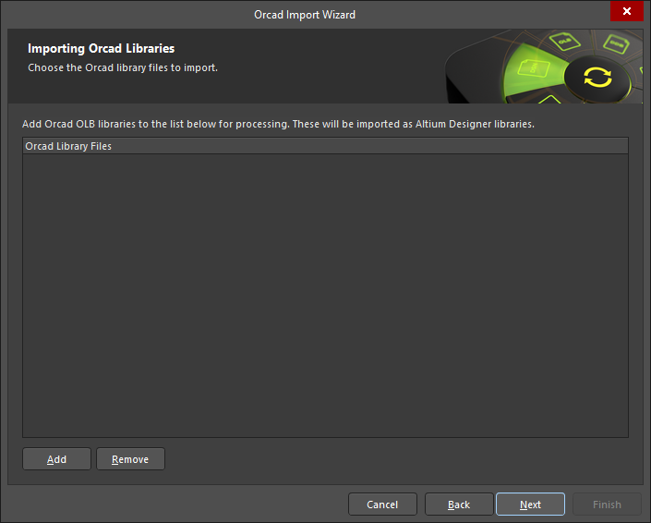
Click Next

Slide 30

Click Next

Slide 31
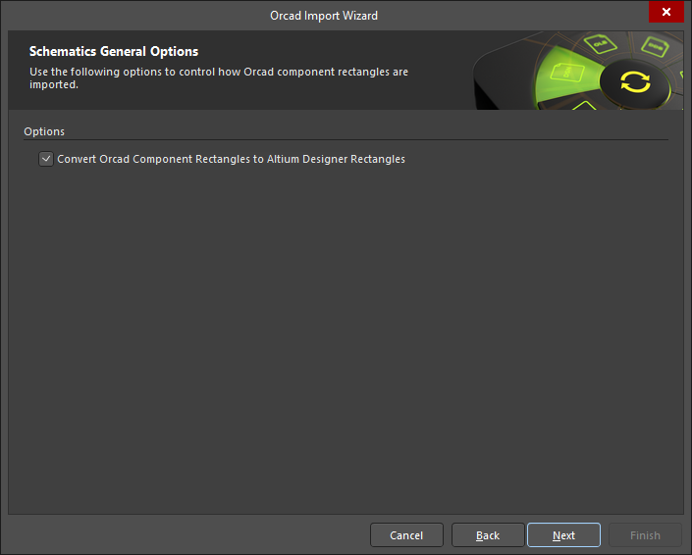
Click Next

Slide 32
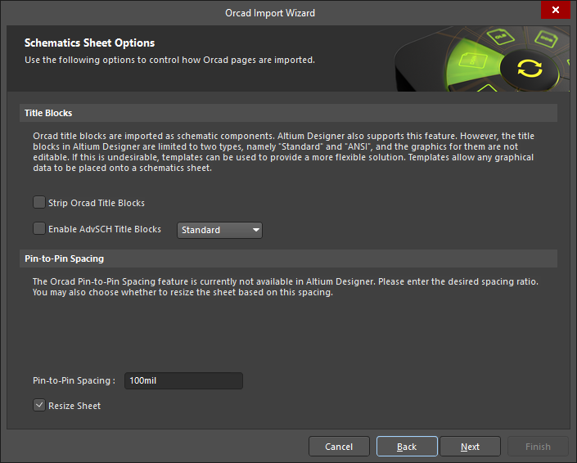
Click Next

Slide 33
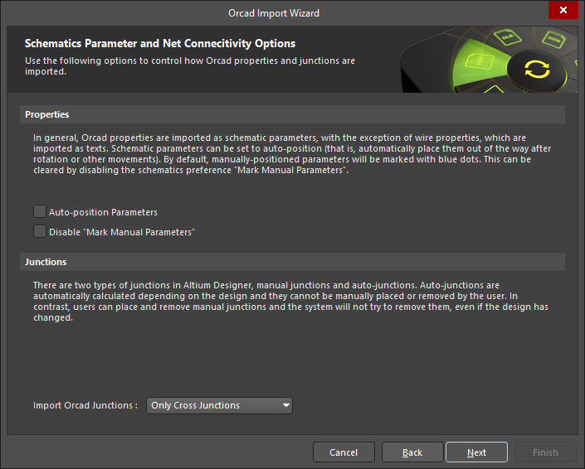
Click Next

Slide 34
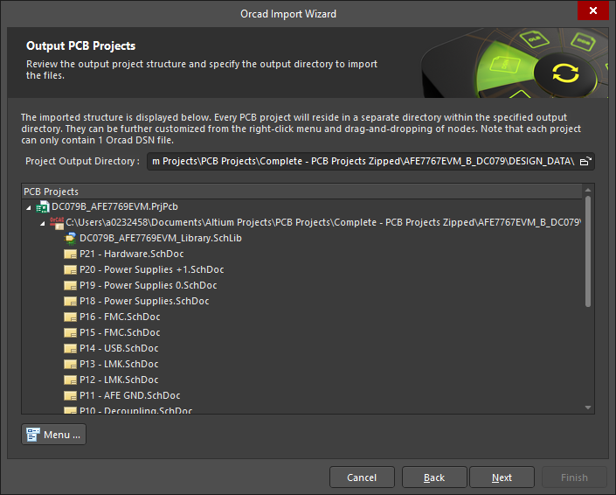
Click Next

Slide 35
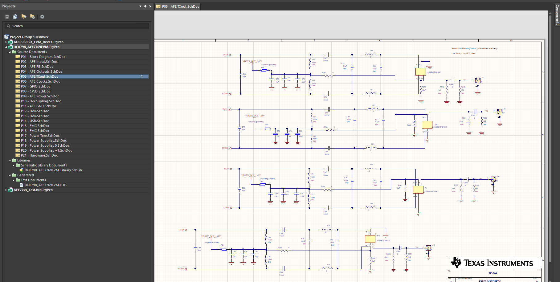
All schematics created

